Slide 1




Advance Analog and Mixed Signal Design
Lecture 1
Oscillator Fundamental
Dr. Neeraj Mishra
High Performance Electronics Lab
Electrical & Electronics Eng. Dept.
Birla Institute of Technology & Science Pilani, Pilani Campus

Slide 2
PROBLEM STATEMENT
Design a digital circuit that:
Detects the bit pattern ‘110’ in a serial bit stream
Searches for 16 consecutive clock cycles only
Begins search when START signal is asserted
A counter is incremented with every clock pulse
When pattern is found → Flip-flop F is SET and operation STOPS
If pattern NOT found within 16 clocks → F remains CLEARED and operation STOPS
Operation can restart when START is asserted again

Slide 3
PART (a): ASM CHART
IDENTIFY THE STATES
Our circuit needs FOUR main states:
ASM = Algorithmic State Machine Chart
It is a flowchart that shows:
Rectangles = States (conditions the circuit can be in)
Diamonds/Ovals = Decisions (checks to make)
Arrows = Transitions (how we move between states)
Actions inside boxes = What happens in each state
Think of it like a recipe with decision points: - “Wait for signal” - “If signal comes, start cooking” - “Check if done” - “If done, stop; if not, keep cooking”
State | Name | What it does
T0 | IDLE | Wait for START signal
T1 | SEARCH | Read bits and look for “110”
T2 | FOUND | Pattern detected! Set output F=1
T4 | STOP | Operation complete, wait for new START

Slide 4
Key Signals in ASM
CONTROLLER DESIGN: ONE-HOT ENCODING
What is One-Hot Encoding?
Use one flip-flop per state. At any time, exactly ONE is active (=1).
Signal | Type | Meaning
S | Input | START signal (external control)
I | Input | Serial input bit
C | Internal | Counter (counts 16 down to 0)
Z | Signal | Z = 1 when counter reaches 0
P | Signal | P = 1 when pattern “110” found
F | Output | Flip-flop (F = 1 if pattern found)
State | T4 | T3 | T2 | T1 | T0
T0 (IDLE) | 0 | 0 | 0 | 0 | 1
T1 (SEARCH) | 0 | 0 | 0 | 1 | 0
T2 (FOUND) | 0 | 0 | 1 | 0 | 0
T4 (STOP) | 1 | 0 | 0 | 0 | 0
T0, T1, T2,T3, T4 | States | Current state indicators

Slide 5
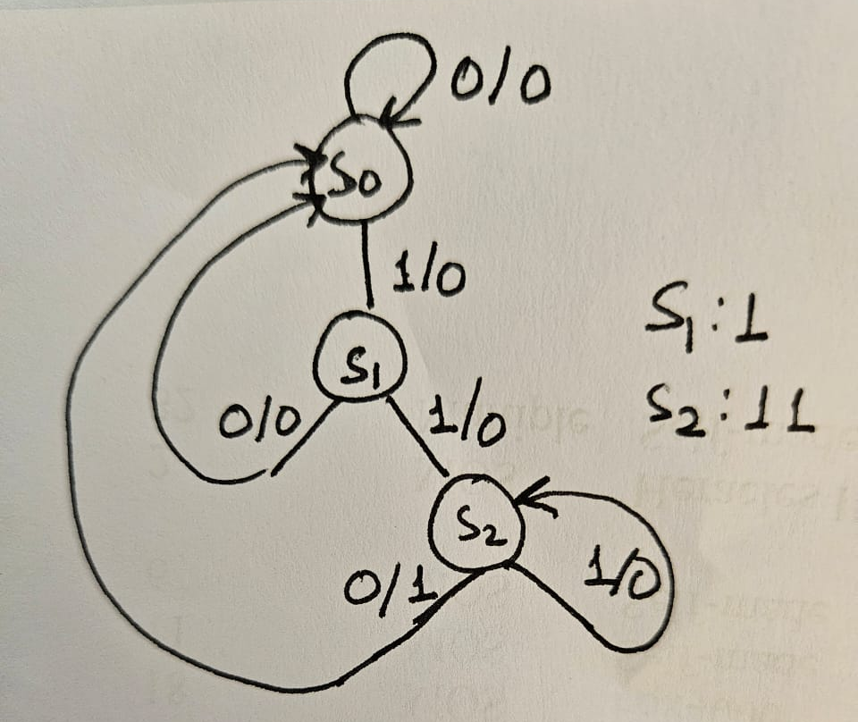
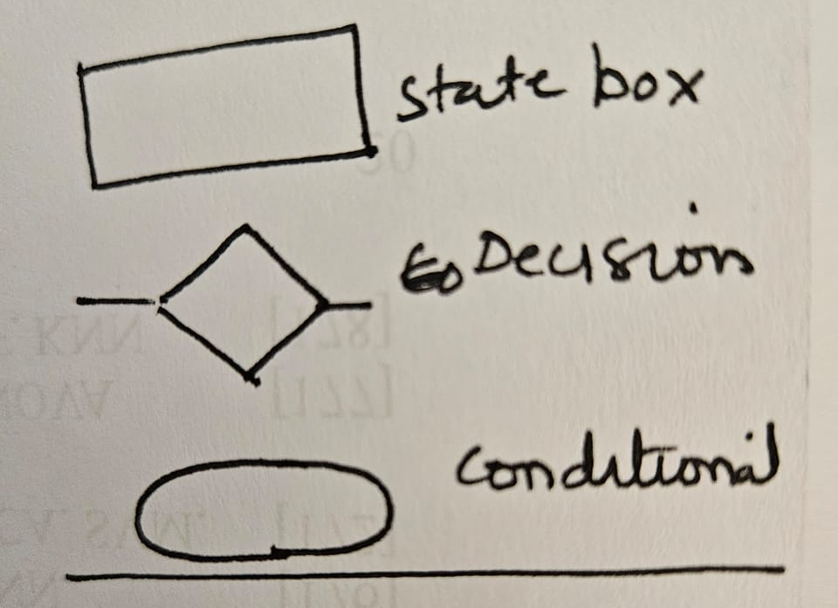
Basics

Slide 6
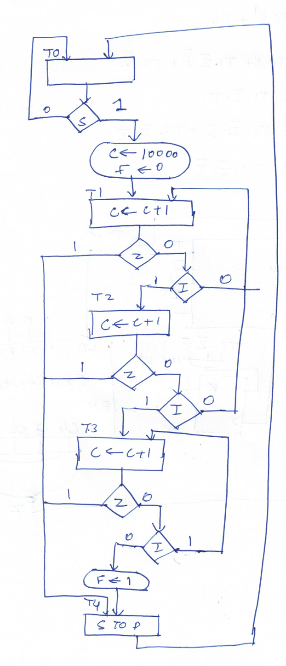
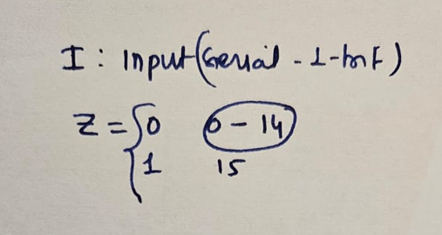
State | Purpose
T0 | IDLE - Wait for START signal
T1 | SEARCH - Search for pattern “110”
T2 | FOUND - Pattern detected, set F=1
T4 | STOP - Operation complete
S: START signal (external input)
I: Serial input bit (incoming data)
C: Counter (incremented each clock: C ← C + 1)
Z: Counter terminal status (Z=1 when C reaches 16 or count expires)
F: Output flip-flop (F=1 when “110” found)
In T1, check two things EVERY clock: 1. Pattern “110” found? → Go to T2 2. 16 clocks passed (counter = 0)? → Go to T4 3. Neither? → Stay in T1, keep searching

Slide 7
These equations define D inputs for the state flip-flops:
DTO = T0·S’ + T4·S’
From T0: Stay in T0 if S=0 (START not asserted)
From T4: Return to T0 from STOP if S=0 (START not asserted)
DTI = T0·S + T1·Z’·I’ + T2·Z’·I’
From T0: Enter T1 when S=1 (START asserted)
From T1: Stay in T1 if counting not complete (Z’=1, meaning Z=0) AND no pattern detected yet (I’=1)
From T2: Continue if counting not complete AND no pattern found
DT2 = T1·Z’·I
From T1: Move to T2 when counting not complete (Z’=1) AND pattern detected (I=1)
DT3 = T2·Z’·I + T3·Z’·I
From T2: Stay or move to T3 based on pattern and count
From T3: Continue based on same conditions
DT4 = T3·Z’·I + (T1+T2+T3)·Z
From T3: Move to T4 under pattern/count conditions
From T1, T2, or T3: Move to T4 when counter expires (Z=1)

Slide 8
T0 → T1 when START=1
T1 loops while searching (Z’=1 and pattern not found)
T1 → T2 when pattern “110” found
T2 → T4 (after setting F=1)
T1 → T4 or T2 → T4 when counter reaches 16 (Z=1)
T4 → T0 when START=1 again

Slide 9
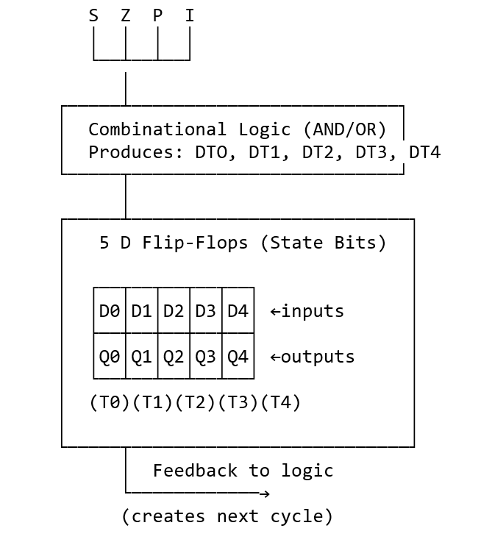
Controller Implementation:
5 flip-flops for one-hot encoding (T0, T1, T2, T3, T4)
Next-state equations determine which state is active next cycle
Inputs: S (START), Z (counter), P (pattern), I (serial bit)
Outputs: T0-T4 state signals to datapath

Slide 10
Component 1: 4-bit Counter
Purpose: Count from 0 to 16 to limit search duration
Operation: - Loads initial value (0) - Increments by 1 on each clock pulse - Output signal Z becomes 1 when counter reaches 16 (or 11111 in binary)
Control Signal: Counter Enable (from T1 state)
Timing:
Clock: 0 1 2 3 ... 15 16
Count: 0 1 2 3 ... 15 16 ← Z becomes 1 here
Component 2: 3-bit Shift Register
Purpose: Maintain the last 3 bits of the input stream to detect “110”
Inputs: - Serial input bit (I) - Shift enable (active during T1 state) - Clock
Outputs: B2, B1, B0 (representing the 3-bit window)
Operation:
Clock Serial Input (I) B2 B1 B0
0 - X X X (initial)
1 0 0 X X
2 1 1 0 X
3 1 1 1 0 ← Can check "110"
4 0 0 1 1 5 1 1 0 1

Slide 11
Component 3: Pattern Detector Logic
Purpose: Detect when shift register contains “110”
Logic:
P = B2 AND B1 AND NOT(B0)
P = 1 when B2=1, B1=1, B0=0
Circuit: One AND gate + one inverter
Component 4: Output Flip-Flop (F)
Purpose: Store and output the “pattern found” status
Set Condition: P=1 (pattern detected in shift register)
Clear Condition: S=1 during T0 (START signal in IDLE state resets the circuit)
Output: - F=1: Pattern “110” found - F=0: Pattern not found within 16 clocks

Slide 12
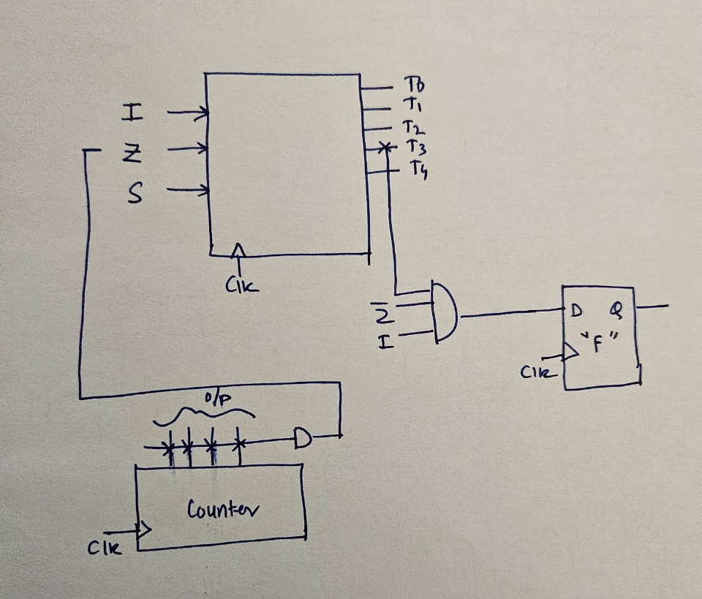
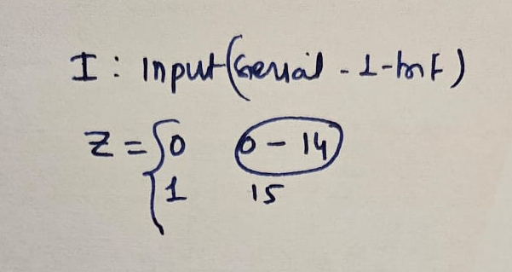

Slide 13
